Slide 1
Variational Autoencoders for image super-sampling
Chad Weatherly
COSC 6372 – Computer Graphics

Slide 2
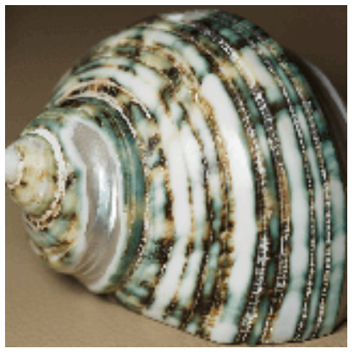
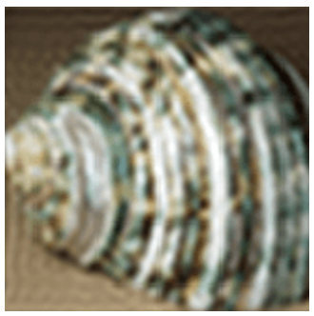
What is Super-Sampling?
Easy
Image Super-Resolution, or Super Sampling, is the process of producing a high-resolution image from a low-resolution one
Lots of research recently
NVIDIA uses Deep Learning Super-Sampling (DLSS) on GPUs to have
High framerates
High quality (4K)
Ray-tracing
Difficult
Image Credit: https://en.wikipedia.org/wiki/Image_scaling

Slide 3
What is Super-Sampling?
DLSS renders low-resolution images and then upsamples them using deep learning
Much faster performance, if images look good!
Image Credit: https://developer.nvidia.com/rtx/dlss

Slide 4
Current Methods
Interpolation
Buggy
Grainy
Blurry
Deep Learning
Better results
More difficult / computationally heavy to train

Slide 5
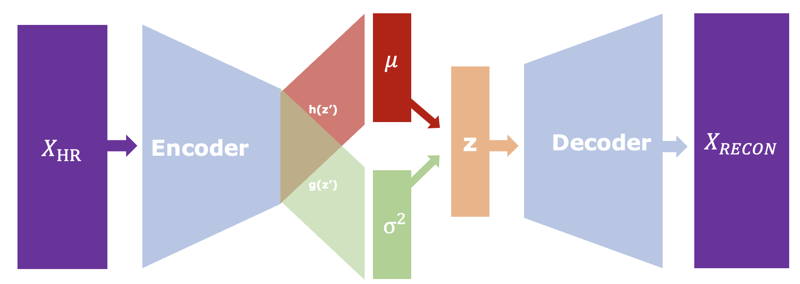
Convolutional VAE
Not used in traditional autoencoder
Uses Convolutional layers in encoder and decoder

Slide 6
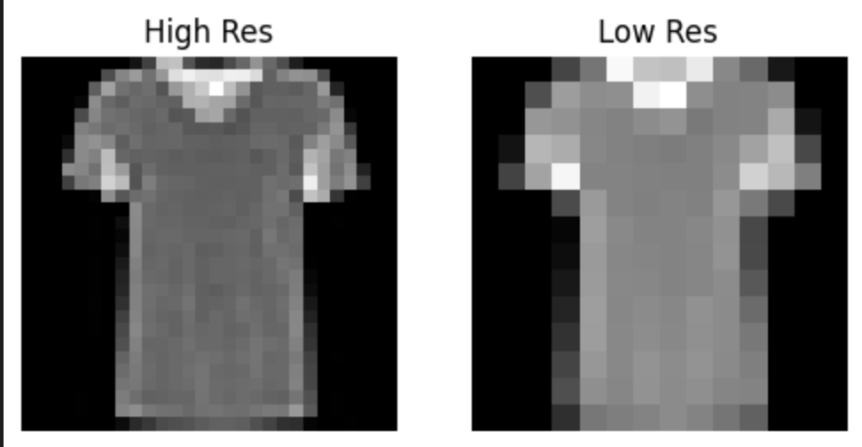
Dataset
Fashion MNIST
Grayscale (1 channel)
28x28 pixels
Each image given a scaled-down counterpart
Low Res
14x14 pixels

Slide 7
Idea
Reconstruct image
Teach Model to recognize hidden structure and frequency content of images

Slide 8
Idea
Reconstruct image
Teach Model to recognize hidden structure of images

Slide 9
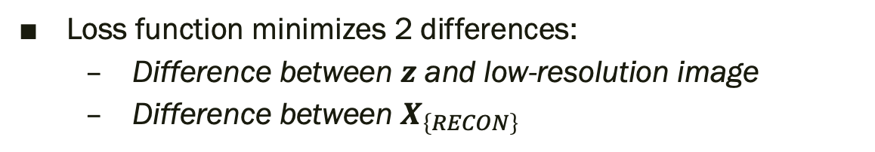
Idea
Loss function minimizes 2 differences:
Difference between $z$ and low-resolution image
Difference between $X_{\left\{RECON\right\}}$
Notes:
We want Low-Res = z and High-Res = X_recon

Slide 10
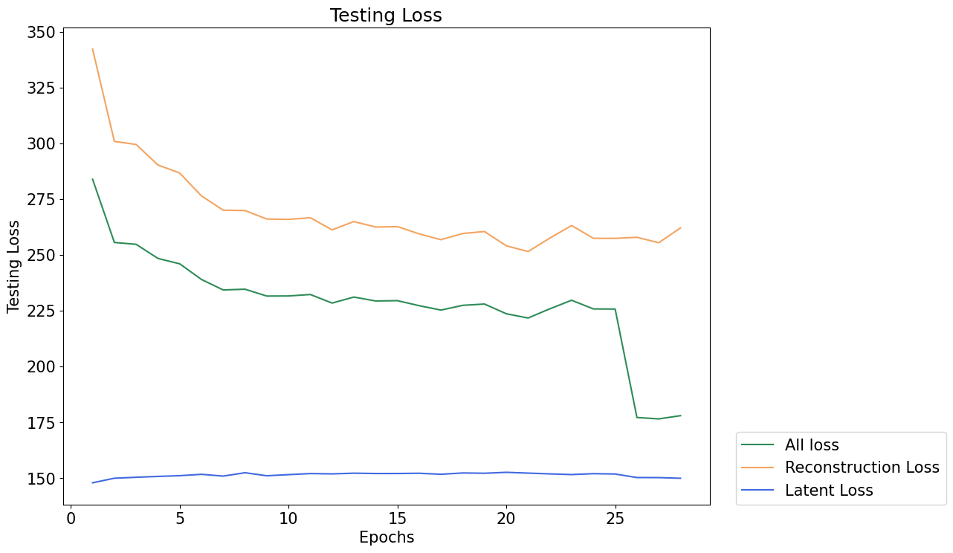
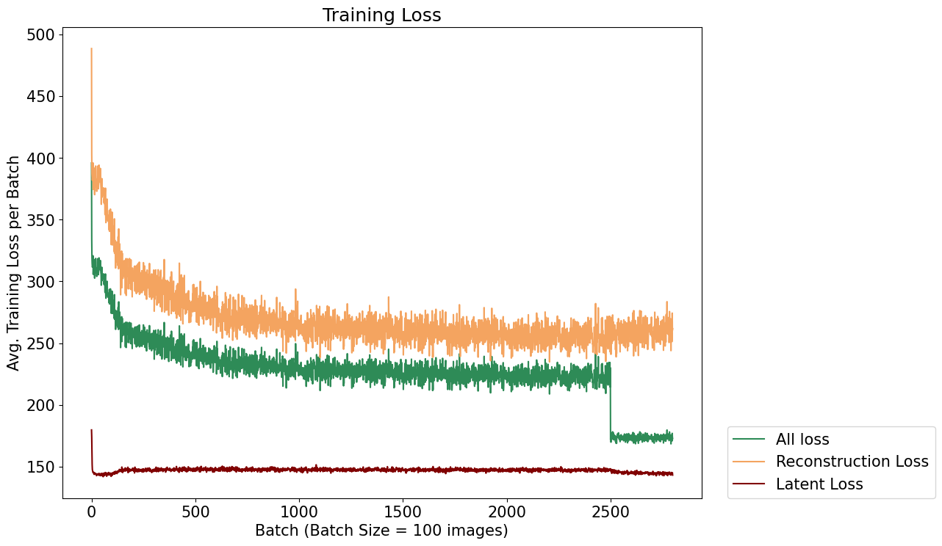
Results

Slide 11
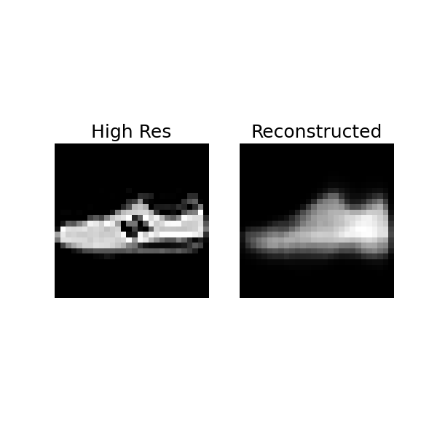
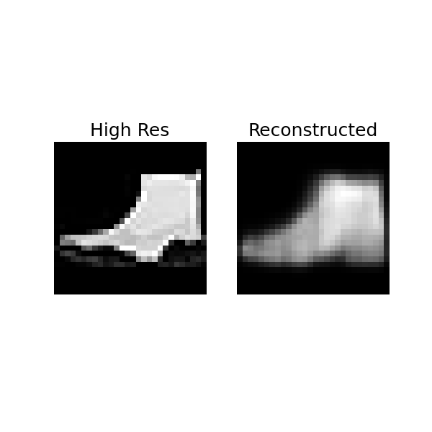
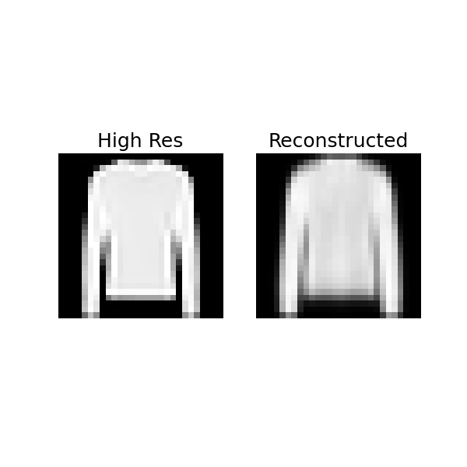
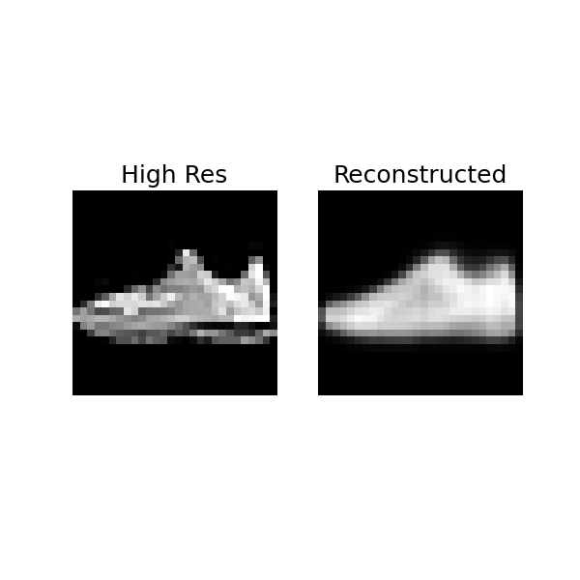
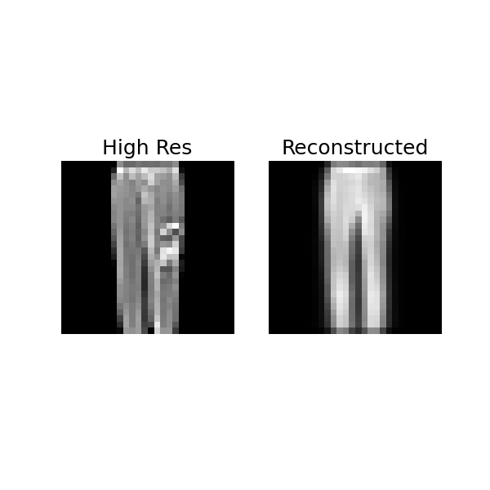
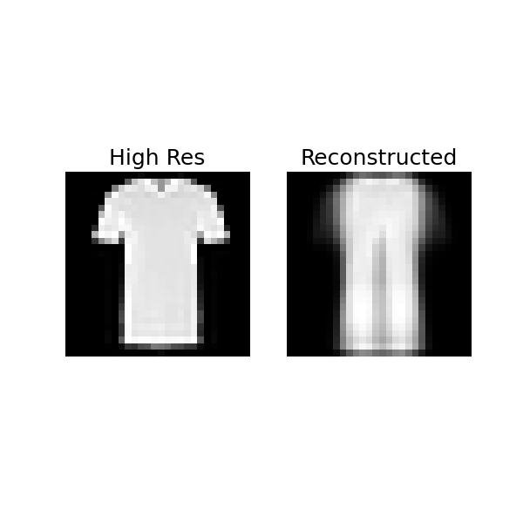
Results – Sample Images

Slide 12
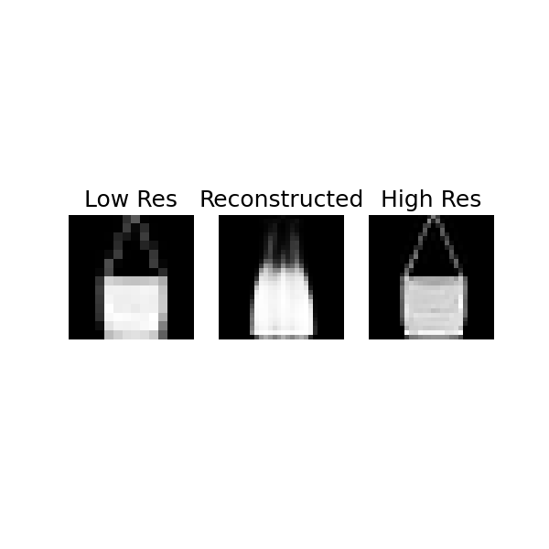
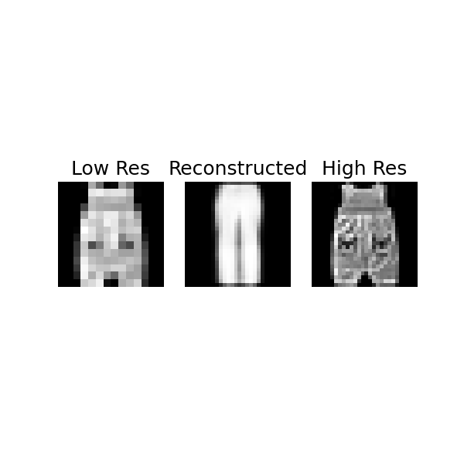
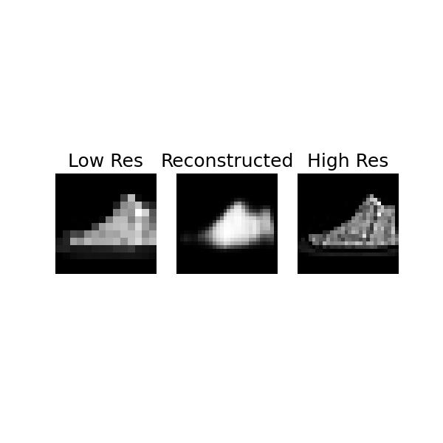
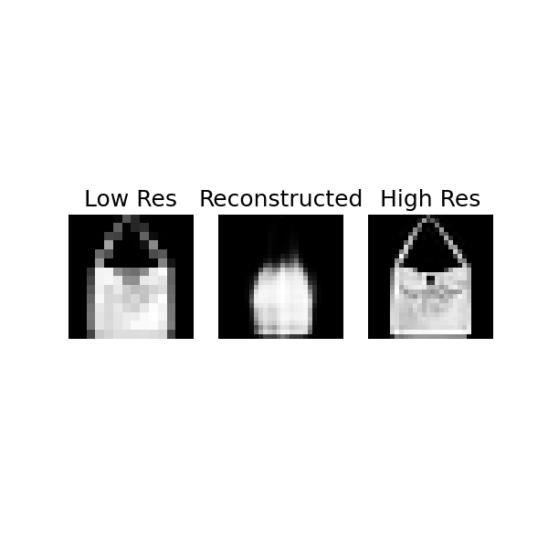
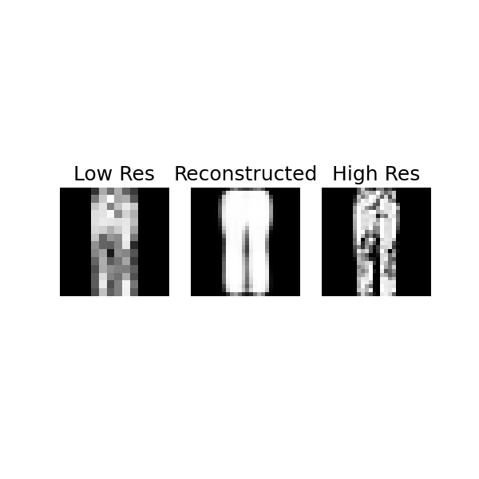
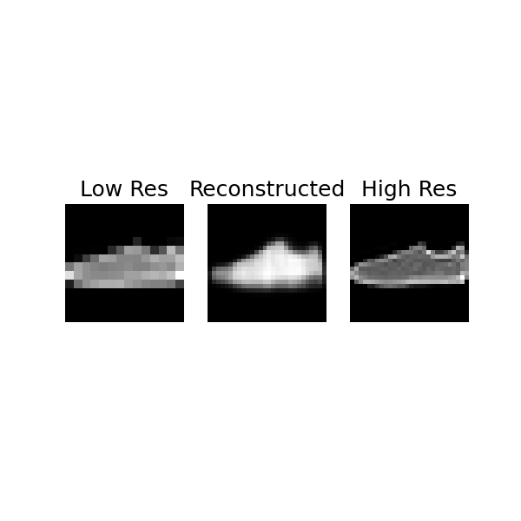
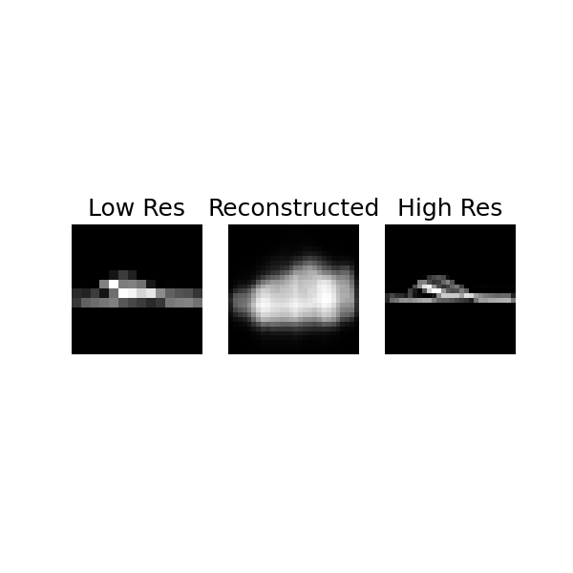
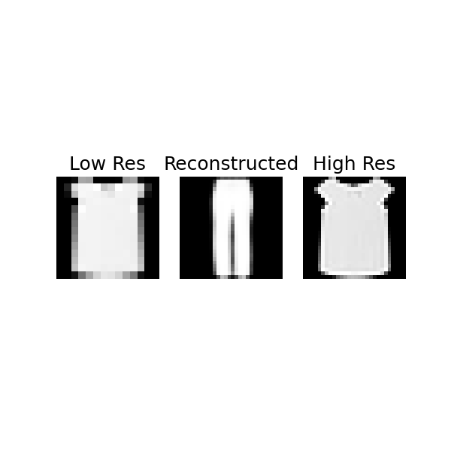
Results – Sample Images

Slide 13
Thank you!
Questions?

